Slide 1
Analytical 6-DOF Robotic Grasp Estimation Based on Surface Normals
Abdullah Cem Özbay
Technical University of Munich
Chair of Media Technology
Munich, 13 June 2023
Notes:
Hello everyone, I am Cem. Today I am presenting the final presentation of my master's thesis Analytical 6- degrees of freedom Robotic Grasp Estimation Based on Surface Normals.

Slide 2
Agenda
Introduction
Background and Motivation
Conclusion and Future Work
Results
Methodology
Notes:
First, I want to give you the agenda for the presentation. Initially, I will give a brief introduction.
we will look at the background and motivation of the topic; then, I will explain the methodology of the research.
After analyzing the methodology, I will share the results.
and finally, I will conclude the topic and give potential future work.

Slide 3
Introduction
Introduction
Background and Motivation
Methodology
Results
Conclusion and Future work
What is Robotic Grasping ?
Grasp and manipulate objects
Analyze the shape and size of the object
Analytical and data-driven methods
Abdullah Cem Özbay | Master’s Thesis | Final presentation, Munich, 13 June 2023
Notes:
Robotic grasping is the manipulation and grasping of objects using a robot's grippers
Sensors and algorithms are used to analyze and understand the shape, size and position of the object.
Typically in the grasping process, the hand's trajectory is planned, the object is approached, and the gripper is closed around it.
Grasping is a complex task due to the variability in object shapes, sizes, and materials. It actually requires pretty complex algorithms.
Robots learn to grasp objects through advanced analytical algorithms and data-driven methods.

Slide 4
Introduction
Introduction
Background and Motivation
Methodology
Results
Conclusion and Future work
State of the art methods:
Analytical Methods
Data-Driven Methods
Abdullah Cem Özbay | Master’s Thesis | Final presentation, Munich, 13 June 2023
Notes:
Both analytical and data-driven state of the art methods have their own downsides.
In Analytical methods like force closure, you need physical parameter of the objects like mass or the friction coefficient.
Or for data-driven methods huge training data sets need to be generated. And the training process is computationally unefficient.

Slide 5
Introduction
Introduction
Background and Motivation
Methodology
Results
Conclusion and Future work
Analytical 6-DOF grasp pose estimation on point clouds without:
Prior knowledge
3D object models
Training data
Overcome the limitations in both analytical and data-driven approaches
Abdullah Cem Özbay | Master’s Thesis | Final presentation, Munich, 13 June 2023
Notes:
The research is about analytical 6 dof grasp pose estimation performed on partial point clouds. In 6 dof, 3 dimensions stands for grasp point position and 3 dimensions for the oriententation of the gripper.
We aimed to exclude the need of any prior knowladge about the object model
and the need for the training data.
By that we expected to overcome the limitations, in both analytical and data driven approaches.

Slide 6
Background: Data-Driven Methods
Introduction
Background and Motivation
Methodology
Results
Conclusion and Future work
Neural Descriptor Fields (NDFs) [1]
PointNet [2]
Convolutional Neural Networks (CNNs) [3]
GraspNet-1Billion with 97,280 RGB-D image [4]
DexNet 2.0 with 6.7 million point clouds [5]
ImageNet with 1.2 million images with 1000 categories [6]
Abdullah Cem Özbay | Master’s Thesis | Final presentation, Munich, 13 June 2023
Notes:
The data-driven models like Neural descriptor fields,point net or cnns are remarkably good at estimating feasible grasp poses.
However, the training process of these models is computationaly unefficient. For example, graspnet 1 billion dataset contains over ninety seven thousand RGB depth images with over one billion grasp poses.
To shorten the duration of the learning process, DexNet 2.0 is presented. However it is also consists of over 6 million point clouds. Or another one is ImageNet. ImageNet is class-based dataset and contains 1.2 million images with 1000 categories.
Overall, althoug data-driven approaches are good at estimating feasible grasp poses, they need large volume of training data

Slide 7
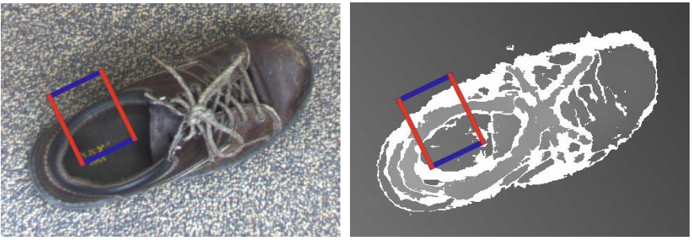
Background: Analytical Methods
Introduction
Background and Motivation
Methodology
Results
Conclusion and Future work
Sliding window
Grasping rectangle representation [7]
Abdullah Cem Özbay | Master’s Thesis | Final presentation, Munich, 13 June 2023
Notes:
Another state-of-the-art method is the rectangular presentation. The defined rectangle window is slid over the image to find the suitable grasp position. A grasp score is assigned for each position of the rectangular window. And the highscoring poses is selected as the best candidate grasp pose.
These rectangular representation usually do not estimate 6-dimensions, instead only find 3D grasp positions. However, estimating only the 3D of the grasp positions often does not perform well in real-life scenarios.

Slide 8
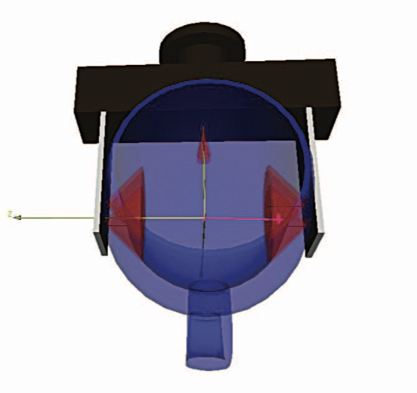
Background: Analytical Methods
Introduction
Background and Motivation
Methodology
Results
Conclusion and Future work
Force closure [8]
Physical parameters
A complete 3D model of the object is required
Abdullah Cem Özbay | Master’s Thesis | Final presentation, Munich, 13 June 2023
Notes:
Another state-of-the-art analytical method is the force closure method. ıts one of the most popular one.
Force closure is a method used to achieve a stable grasp on an object.
It aims to apply force or pressure on object through the robot's grippers. In such a way, the object is held securely without slipping.
Force closure methods relies heavily on precise geometric information and complete 3D models of objects.
In real-world scenarios, obtaining such detailed models may not always be possible,
This situation restricts the feasibility of these methods.

Slide 9
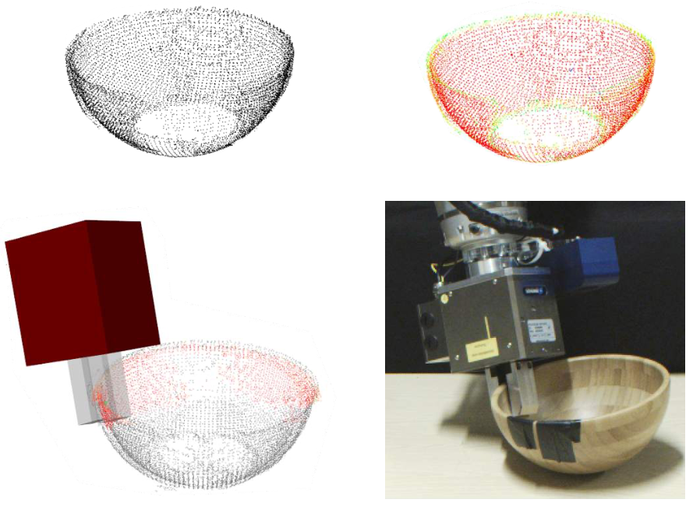
Background: Analytical Methods
Introduction
Background and Motivation
Methodology
Results
Conclusion and Future work
Local contact moment matching [9]
Zero-moment shift features
Surface geometry similarities
Abdullah Cem Özbay | Master’s Thesis | Final presentation, Munich, 13 June 2023
Notes:
Next, another analytical method is local contact moment matching. Here they use zero-moment shift features. They define a sphere as a grasping area and then compute the offset/shifts of the points from the centroid of this sphere.
Then, they define a local contact momnet metric. The metric compare these shifts on the object surface and the gripper finger.
They state that zero moment shift features represent the properties of local regions of the surface ;, and are especially good at encoding information about surface curvature

Slide 10
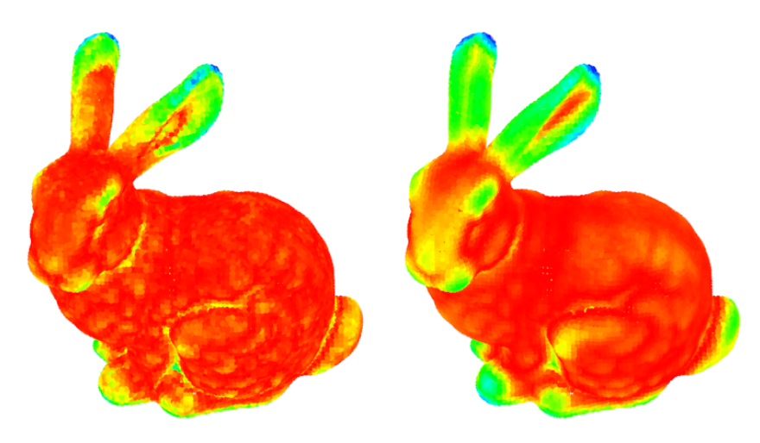
Background: Analytical Methods
Introduction
Background and Motivation
Methodology
Results
Conclusion and Future work
Local contact moment matching [9]
L1 norm of the zero-momnet shift
Abdullah Cem Özbay | Master’s Thesis | Final presentation, Munich, 13 June 2023
Notes:
Here we have an example from the paper of this methods. They state that the L1 norm of the zero-moment shift is a good indicator of the surface's characteristics.
The colors: Red, Yellow, Green, and Blue encode in increasing order the magnitude of the L1 norm of the zero moment shift vector.
High values (Blue here) are observed on ears with high curvatures and low values (Red) on surfaces with low curvatures.
This paper was also our inspiration for developing our own method that searches the local surface similarities between object and the gripper finger based on surface normals.

Slide 11
Motivation
Introduction
Background and Motivation
Methodology
Results
Conclusion and Future work
High computational cost
Low performance on unseen objects
Abdullah Cem Özbay | Master’s Thesis | Final presentation, Munich, 13 June 2023
Notes:
Data-driven approaches require training and learning from huge data sets. This learning process is computationaly unefficient.
Besides, Learning based methods might perform poor on unseen objects. Which are not included in the dataset or not represented accurately enough in the dataset.

Slide 12
Problem Formulation
Introduction
Background and Motivation
Methodology
Results
Conclusion and Future work
No training required
Reduce computational cost
Generalized method
Not class-based
Abdullah Cem Özbay | Master’s Thesis | Final presentation, Munich, 13 June 2023
Notes:
Our goal is to find feasible grasp poses, only examinig the geometry of the object. That’s why, our method based on surface normals. These surface normals represents the surface orientation of the objects.
unlike data-driven approaches, we can exclude the need for training data. Without the traning, we expected to reduce the computational cost.
Another advantage of our method is to be more generalized. Since there is no learned dataset, our method is expected to perfom well on unseen objects.
It ıs also not class based. This allows the method to be versitale on grasping various types of objects .

Slide 13
The Pipeline Overview
Introduction
Background and Motivation
Methodology
Results
Conclusion and Future work
Abdullah Cem Özbay | Master’s Thesis | Final presentation, Munich, 13 June 2023
Notes:
Here we have the pipeline overview of the algorithm. First the point cloud is preprocessed and the region of interest is defined. it is where grasp will occur.
Next we estimate the surfca normals of the pointcloud. Then candidate grasp poses are generated over the point cloud in the region of interest.
Then we check the constraintes. And the grasp poses that collide with the enviorenment are eliminated.
A grasp score is aasigned to each remaining cadidate grasp pose.
The grasp poses are sorted depending on their grasp scores.
The highest scoring 6d grasp pose confşguration given to robots motion palnning. And it is executed by the robot.

Slide 14
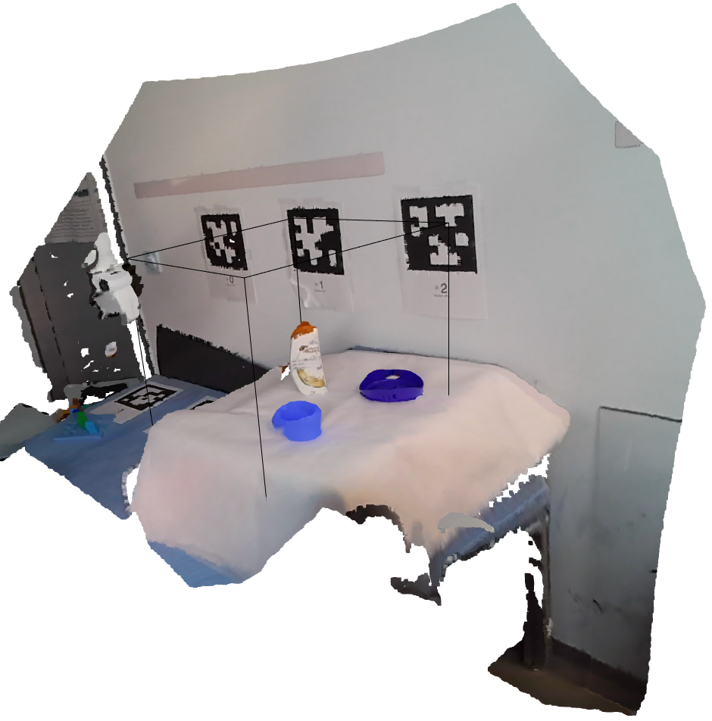
Scene Capturing and Point Cloud Creation
Introduction
Background and Motivation
Methodology
Results
Conclusion and Future work
Capture the scene via RGB-D camera
Abdullah Cem Özbay | Master’s Thesis | Final presentation, Munich, 13 June 2023
Notes:
First we capture the point cloud through a rgb depth camera.
Since rgb-d cameras can only see one side of the objects, we can only obtain partial point clouds.
here we see the point cloud from cameras perspective.
The camera is located on the front right side of the table.

Slide 15
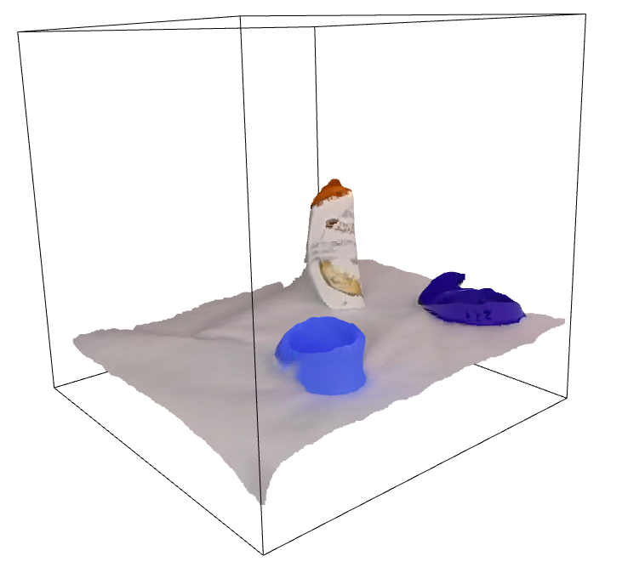
Point Cloud Pre-processing
Introduction
Background and Motivation
Methodology
Results
Conclusion and Future work
Identify a region of interest in the point cloud
Abdullah Cem Özbay | Master’s Thesis | Final presentation, Munich, 13 June 2023
Notes:
Then we assume that we know the region of interest, which in this case, is the table. And we crop this region by defining a bounding box around it.
In the figure, you see the region of interest, where all the target objects are located.
To find suitable grasp poses, the algorithm does actually not require defining a region of interest
but wanted to define this region of interest, aiming to reduce the number of points to visit.
Sooo actually defining a region of interest does not affect the performance of the developed method

Slide 16
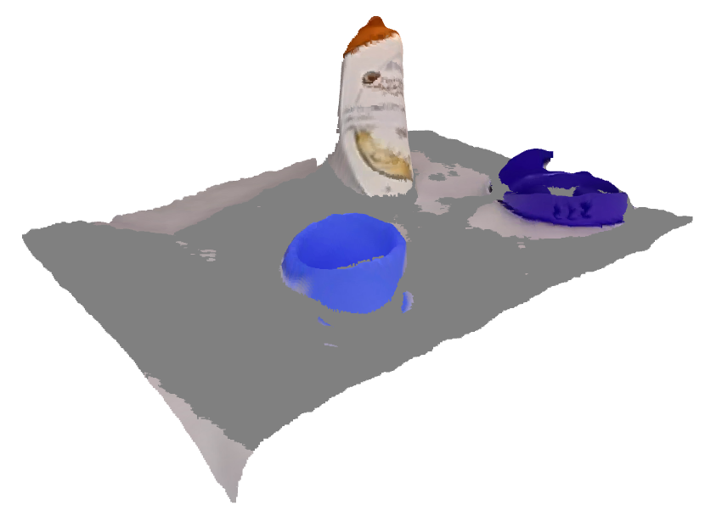
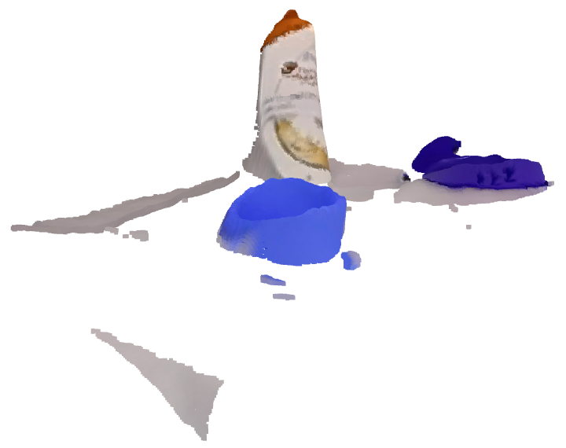
Point Cloud Pre-processing
Introduction
Background and Motivation
Methodology
Results
Conclusion and Future work
Remove the ground surface (Open3D)
Abdullah Cem Özbay | Master’s Thesis | Final presentation, Munich, 13 June 2023
Notes:
Next we remove the ground surface of the point cloud. This because we wanted to optimize the computation time. Further steps we will sample candidate grasp poses on the point cloud. -------So candidate grsp poses are sampled on points of the point cloud
and sampling on ground surface wont make sense since they are not desired poses for grasping
To remove the ground surface, we define a plane equation. Using RANSAC (Random Sample Consensus ) algorithm we segment and remove the planar surface from the point cloud. With this equation two planes are obtained: The first one, selects inlier points, which lie on the detected plane. The second one, selects outlier points, which are points that do not belong to the detected plane.
By that, we got the point cloud with the removed ground surface.

Slide 17
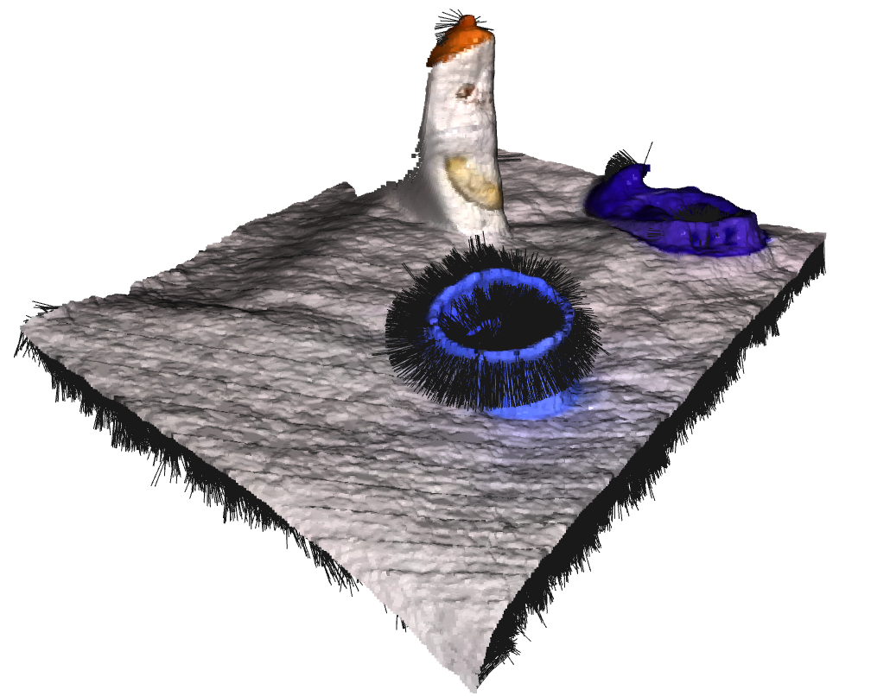
Surface Normal Estimation
Introduction
Background and Motivation
Methodology
Results
Conclusion and Future work
Represents the local orientation of the surface
Surface normals is used to determine a grasp quality metric
KDTree search from Open3D
Parameter fine-tunnig
Radius = 0.1
Max NN = 12
Abdullah Cem Özbay | Master’s Thesis | Final presentation, Munich, 13 June 2023
Notes:
Our approach for grasp pose estimation is based on surface normals, that’s why an accurate surface normal estimation is very important.
Surface normlas reprents the local orientation of the surface.
Here on the figure, normals are reprsented with the black vectors on the point cloud.
In order to obtain surface normals we implemeted a function on point cloud from Open3d that uses KDTree search.
By parameter fine-tuning we got the optimized value for radius as 0.1 and maximum number of neighbors as 12. This values varies depending on the point cloud. But thisvalues suits to differt pc as well.

Slide 18
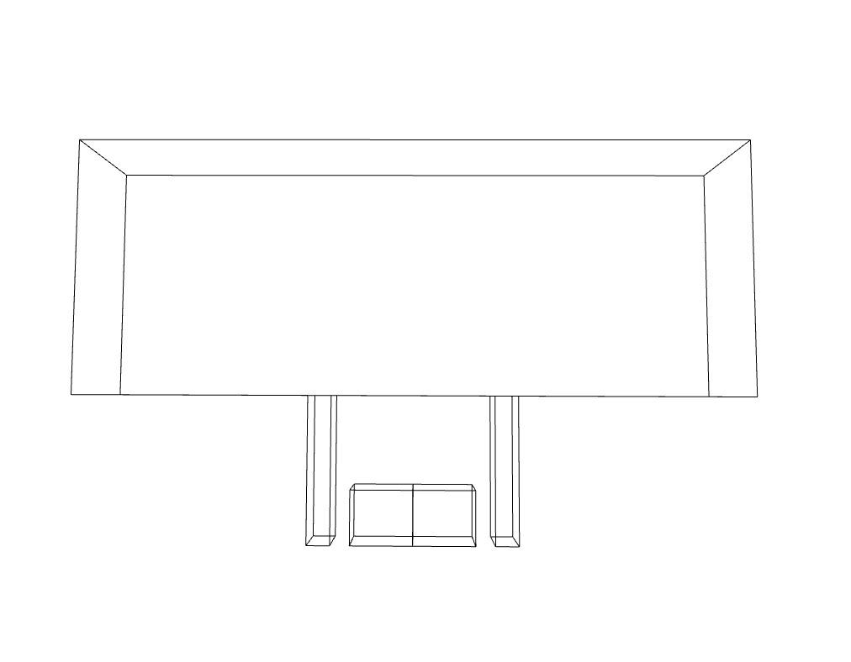
Define Gripper
Introduction
Background and Motivation
Methodology
Results
Conclusion and Future work
Gripper representation
Collision detection
Gripper Body
Gripper Finger Body
Grasping Area
Abdullah Cem Özbay | Master’s Thesis | Final presentation, Munich, 13 June 2023
Notes:
Next, We define the gripper as bounding boxes. We work on paralel jaw gripper, soo One large box for the body of the gripper , two boxes for the body of the fingers and two boxes between fingers that represents the grasping area.
Size of these bounding boxes are corresponds to the actual measurements of the gripper physically.
Using bounding boxes between fingers, we can analyze points of the point cloud for grasp pose sampling.
I will explain this further in detail.
I addition we make collision detection using the bounding boxes of the body and finger body of the gripper. If points inside those boxes are found then this means gripper woukd collide with the experiment enviorenment.

Slide 19
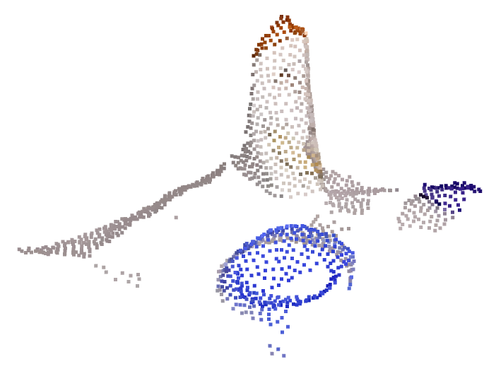
Grasp Pose Sampling
Introduction
Background and Motivation
Methodology
Results
Conclusion and Future work
Down-sample the point cloud using farthest point down-sampling from Open3D
Sample random oriented grasp poses on down-sampled point cloud
Homogenues analyses of candidate grasp poses
Abdullah Cem Özbay | Master’s Thesis | Final presentation, Munich, 13 June 2023
Notes:
After creating the gripper representation, we sample candidate six dof poses on downsampled point cloud.
In order to analyze the point cloud homogeneously, we used farthest point sampling from Open3d library.
In the right side of the slide you can see the down-sampled version of the point cloud.
We generate candidate grasp poses on the points ol downsampled point cloud with random 3 dimensional orientation.
So if point cloud consist of two hunderd thousad points, we only visit twenty thousand points. By that we ensure a plausible computation time.

Slide 20
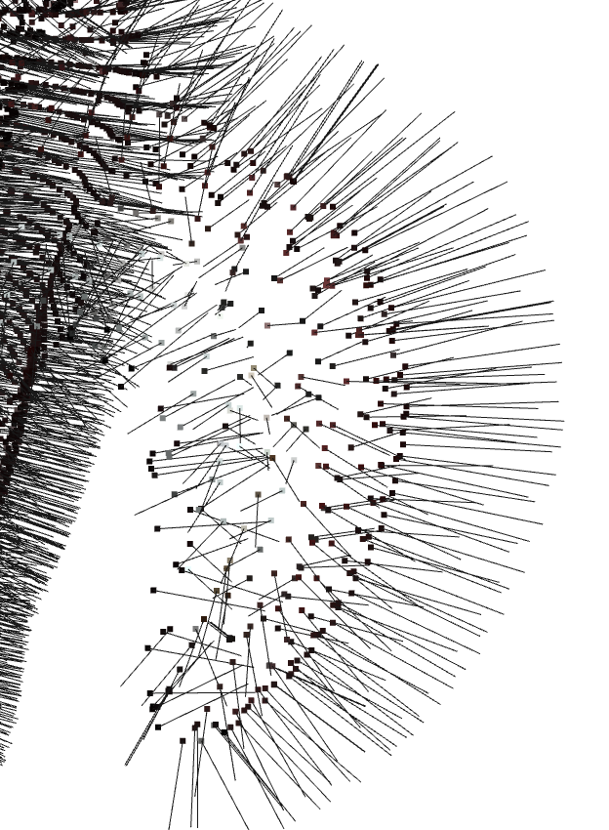
Grasp Pose Sampling
Introduction
Background and Motivation
Methodology
Results
Conclusion and Future work
Align gripper to the object surface
Dominant normal
Points inside the grasping area bounding box
Abdullah Cem Özbay | Master’s Thesis | Final presentation, Munich, 13 June 2023
Notes:
After initiating the candidate grasp pose, it is aligned to the object point cloud with dominant normal direction.
We compute dominant normal by averaging normals of each point between the gripper fingers, which is the grasping area.
Here for example, let us assume, we have here the bounding box of the grasping area. The dominant normal is the average of all those normal vectors inside the blue box.
Here, dominant normal is demostraded in red vector.
When we multiply dominant normal by minus 1, we get oposite direction for the dominant normal , and it is the desired normal of the aligned grasp pose.

Slide 21
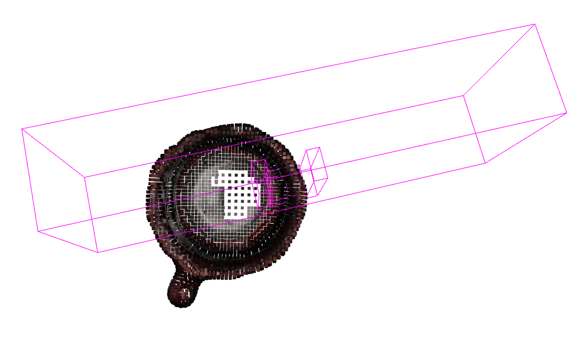
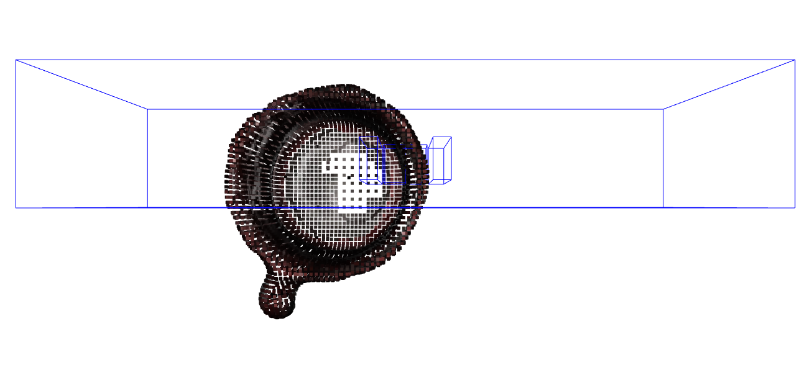
Grasp Pose Sampling
Introduction
Background and Motivation
Methodology
Results
Conclusion and Future work
Align gripper to the object surface
Grasp pose is aligned
Abdullah Cem Özbay | Master’s Thesis | Final presentation, Munich, 13 June 2023
Notes:
Then, we calculate the angle between desired normal and the normal of the random oriented gripper. Here it is shown on the left in blue.
Afterwards, we rotate blue gripper with this angle and obtain the aligned gripper pose.
You can see the aligned gripper pose in the magneta color. It is aligned to the curve of the mug.

Slide 22
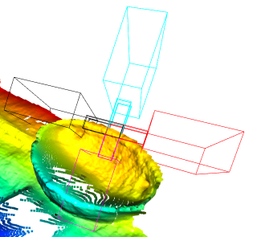
Grasp Pose Sampling
Introduction
Background and Motivation
Methodology
Results
Conclusion and Future work
Rotate around x-axis every 30 degrees
Check the (collision) constraint: Point Cloud ∩ Gripper Body = ∅
Iteration for different grasp widths from 2cm to 10cm
Abdullah Cem Özbay | Master’s Thesis | Final presentation, Munich, 13 June 2023
Notes:
Soo, Once the gripper is aligned, the grasp poses are sampled by rotating them around the x-axis. it is rotated every 30 degrees until a full round is completed. This means we obtain twelve pose for each grasp point. here on the example figure, it is rotated by 90 degress, it is just to show this rotation clearly.
Then we check our constraint. So we check whether any of these rotated poses collide with the point cloud if so we eliminate the pose.
To check the collision we look if any points are inside gripper body or gripper fingers body.
At the end , this whole grasp pose sampling is repeated for different grasp widths from 2 cm to 10 cm.
Any other rotation angle or grasp width is also possible. these are actually parameters of the algorithm

Slide 23
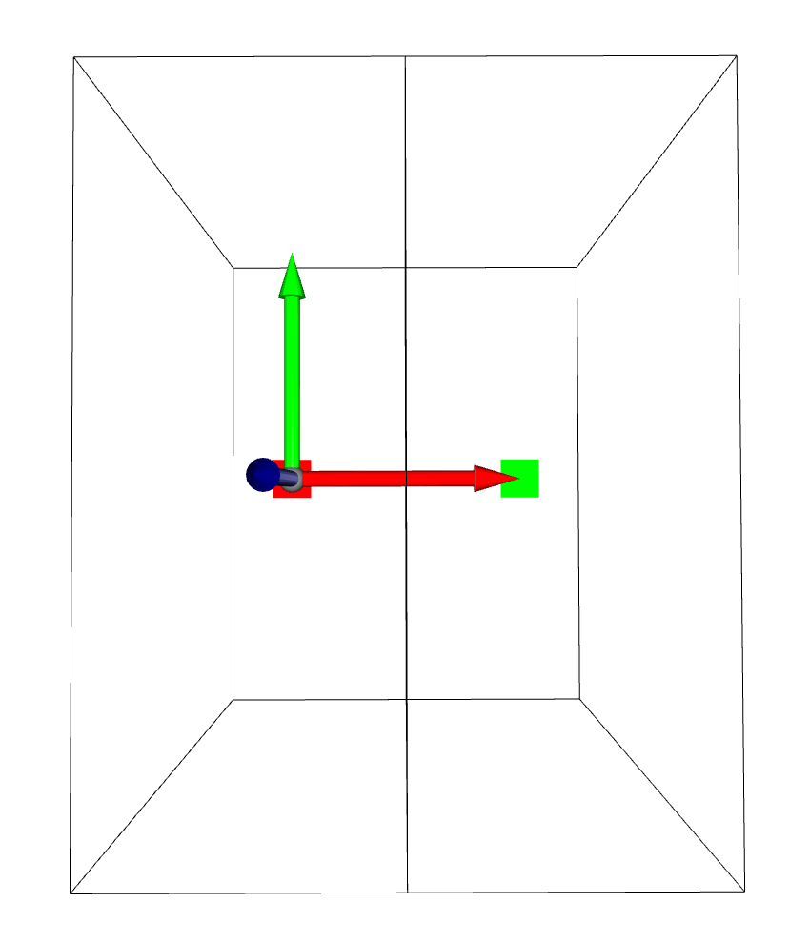
Grasp Score
Introduction
Background and Motivation
Methodology
Results
Conclusion and Future work
Left side of the
gripper finger
Right side of the
gripper finger
Surface normal of the gripper finger
Normal of left the finger = center_r – center_l
center_r
Left finger
Right
finger
center_l
Grasping area
Abdullah Cem Özbay | Master’s Thesis | Final presentation, Munich, 13 June 2023
Notes:
Here we have the representation of the gripper fingers and the grasping area in between. (red and green surfaces)
In order to search for the surface similaries between object’s surface and gripper finger, We first compute surface normals of each gripper finger.
This normal of the red finger surface is calculated by subtracting center of the finger's bounding box on the right side from that on the left side.
Then obtained vector, is here the red arrow, is normalized
The normals of the fingers have the same magnitude and opposite directions. So the black arrow represents the normal of the gripper finger on the right side.

Slide 24
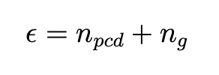
Grasp Score
Introduction
Background and Motivation
Methodology
Results
Conclusion and Future work
Surface similarity metric
Error = Difference between object’s and gripper finger’s surface normal
n_pcd = surface normal of the point on the point cloud
n_g = surface normal of the finger
Abdullah Cem Özbay | Master’s Thesis | Final presentation, Munich, 13 June 2023
Notes:
After sampling the candidate grasp pose and rotating it by 30 degrees. The colliding grasp poses are eliminated.
Now , We calculate the grasp score for each non colliding pose.
In order to compute grasp score we define surface similarity metric.
Similarity error between the object surface and gripper finger is defined.
The surface normals of the object point inside the current aligned and rotated pose and the surface normal of the finger are summed.
I mean, we have two boxes in the grasping area,
and each point normal in the first bounding box is summed with the corresponding finger normal to that box
and the points in the other box are summed with the normal of the other finger.
Soo, we obtain the difference between the normals by adding them to each other.

Slide 25
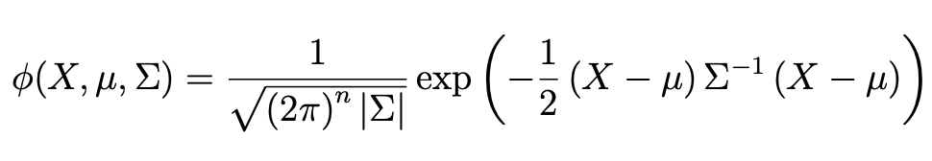
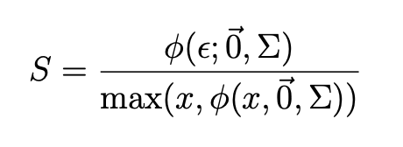
Grasp Score
Introduction
Background and Motivation
Methodology
Results
Conclusion and Future work
Resulting error is inserted into the gaussian function
Overall grasp score of the poses is calculated by averaging grasp score of each point inside the gripper fingers
Abdullah Cem Özbay | Master’s Thesis | Final presentation, Munich, 13 June 2023
Notes:
The resulting error is inserted into the gaussian function that maps the grasp score for the point. İn his function : mean value is a zero vector and Sigma is a 3d unit matrix.
Then we normalize the grasp score. By that we obtain grasp scores between 0 and 1.
This process iterated for all points inside gripper fingers.
AND
Overall grasp score of the candidate grasp pose is calculated by averaging grasp scores of each of those point.

Slide 26
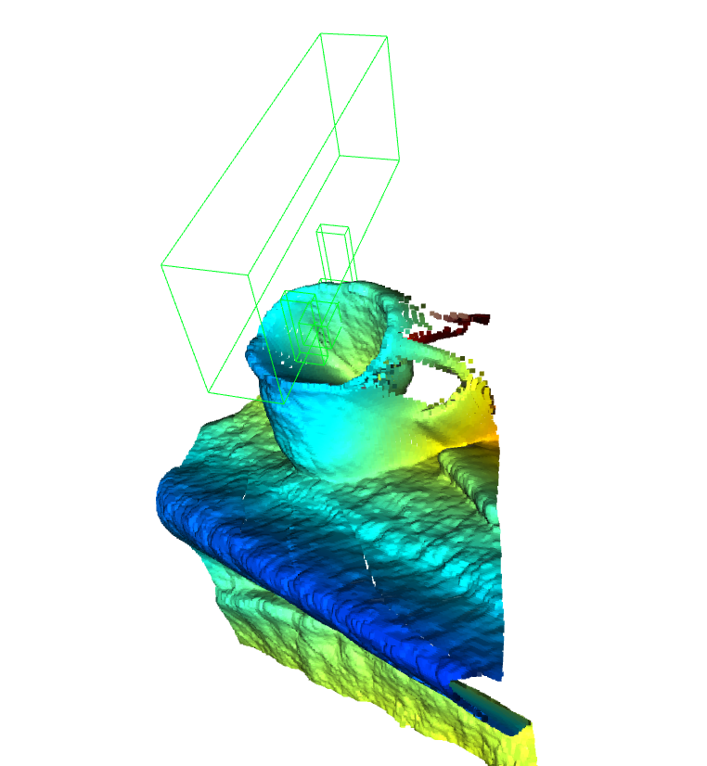

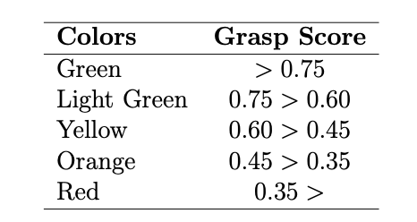
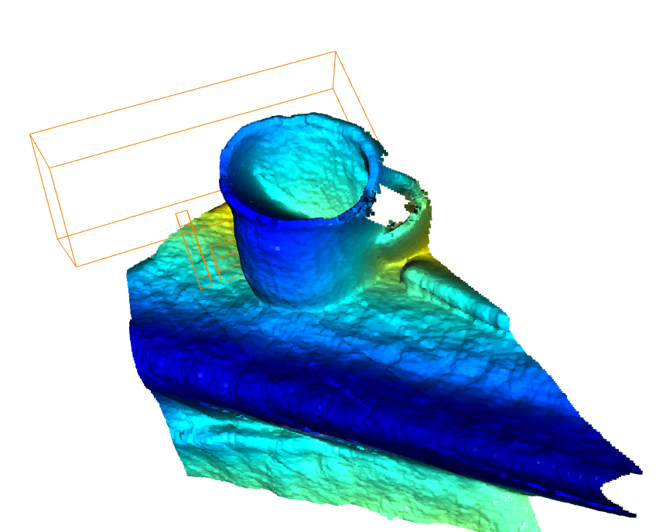
Grasp Score
Introduction
Background and Motivation
Methodology
Results
Conclusion and Future work
Abdullah Cem Özbay | Master’s Thesis | Final presentation, Munich, 13 June 2023
Notes:
Here we have table for grasp score representation.
High-scoring grasp poses are represented in green, mediocare ones are in yellow and the low-scoring grasp poses are represented in red.
In figure on the right you can see here for example high-scoring grasp pose is represneted in green and
here bottom right, low scoring grasp pose in orange.

Slide 27
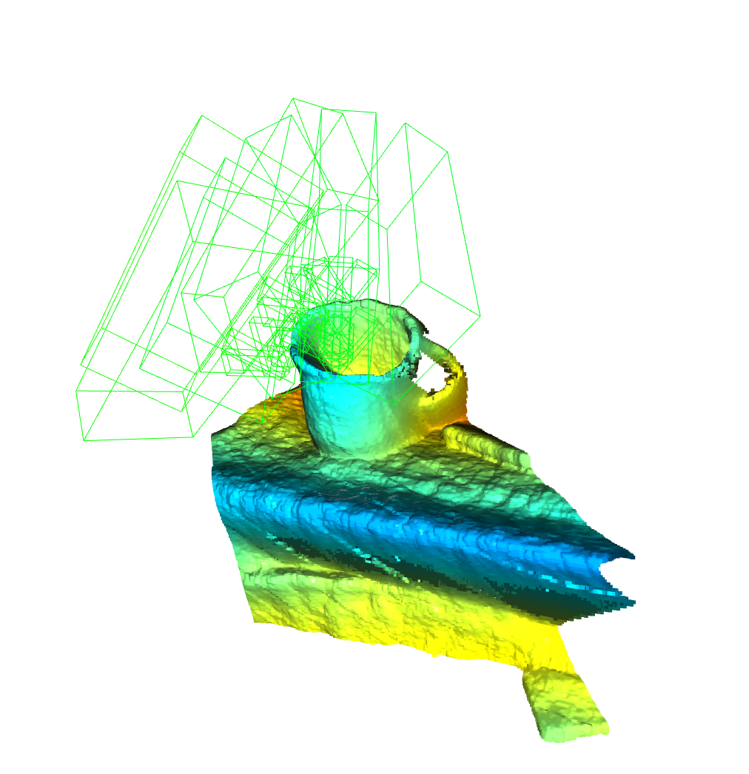
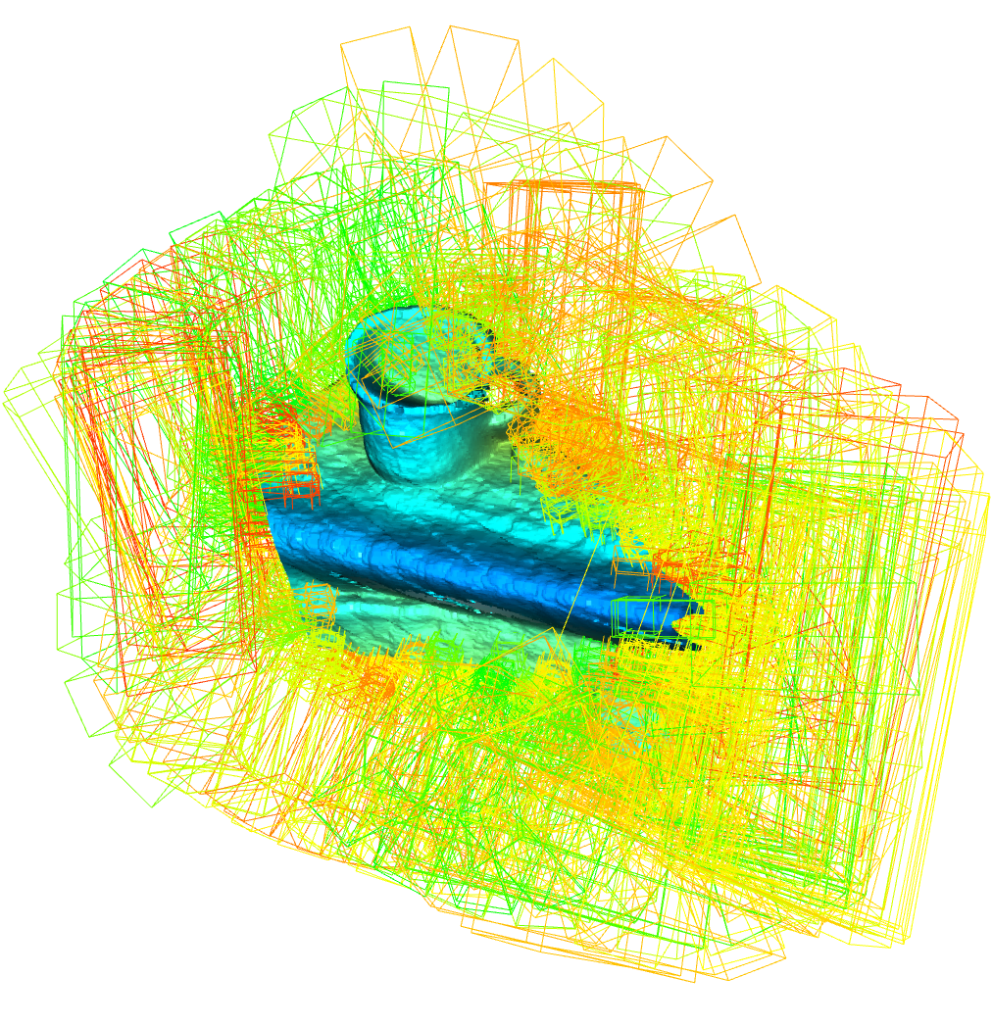
Eliminating Grasp Poses on Edges
Introduction
Background and Motivation
Methodology
Results
Conclusion and Future work
Reduced process time
Grasp poses on the edges are eliminated
Abdullah Cem Özbay | Master’s Thesis | Final presentation, Munich, 13 June 2023
Notes:
After generating candidate grasp poses, we obtained too many poses on the edges of the reigon of interest. Those poses had high grasp scores because the edge surfaces of the point cloud are flat.
However, these are obiously not feasible.
And, This situtation harms the algorithm by increasing the computational time.
To eliminate candidate grasp poses on the edges, we defined a smaller region of interest . to do that we define a smaller bounding box around the objects. And grasp poses are sampled in this area. Those at the edges of the smaller area collide with the initial region of interest. so they are eliminated.By eliminating the poses on the edges, process time of the method is decreased. and only suitable grasp poses are left
(ensure redundancy, incase all the non feasible surfaces are not removed in surface removing part )

Slide 28
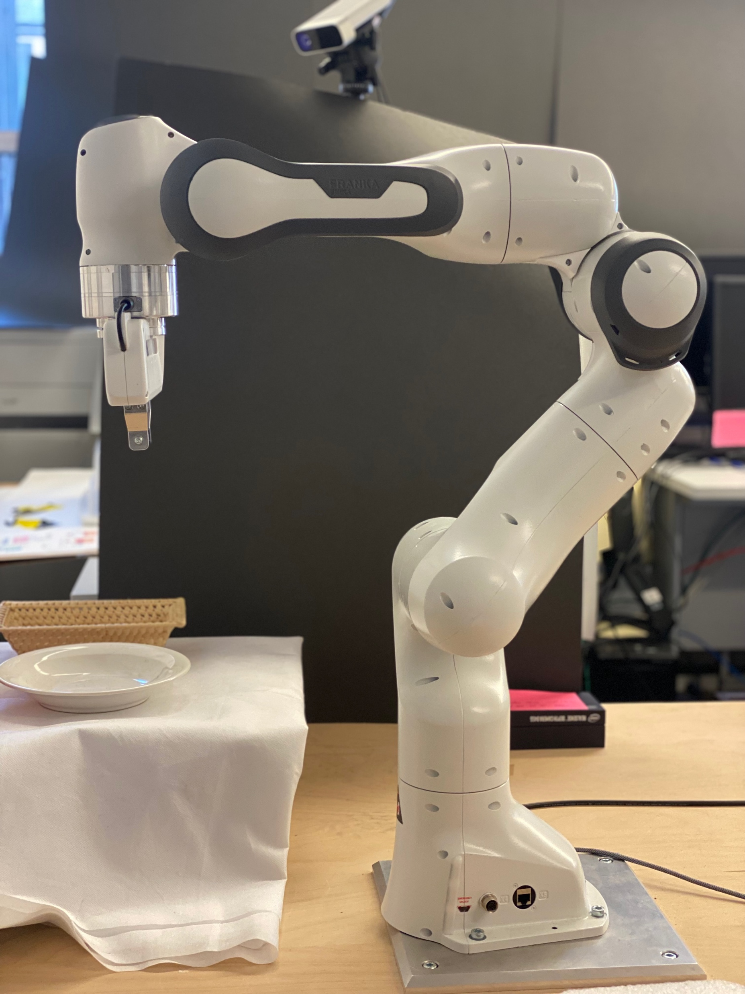
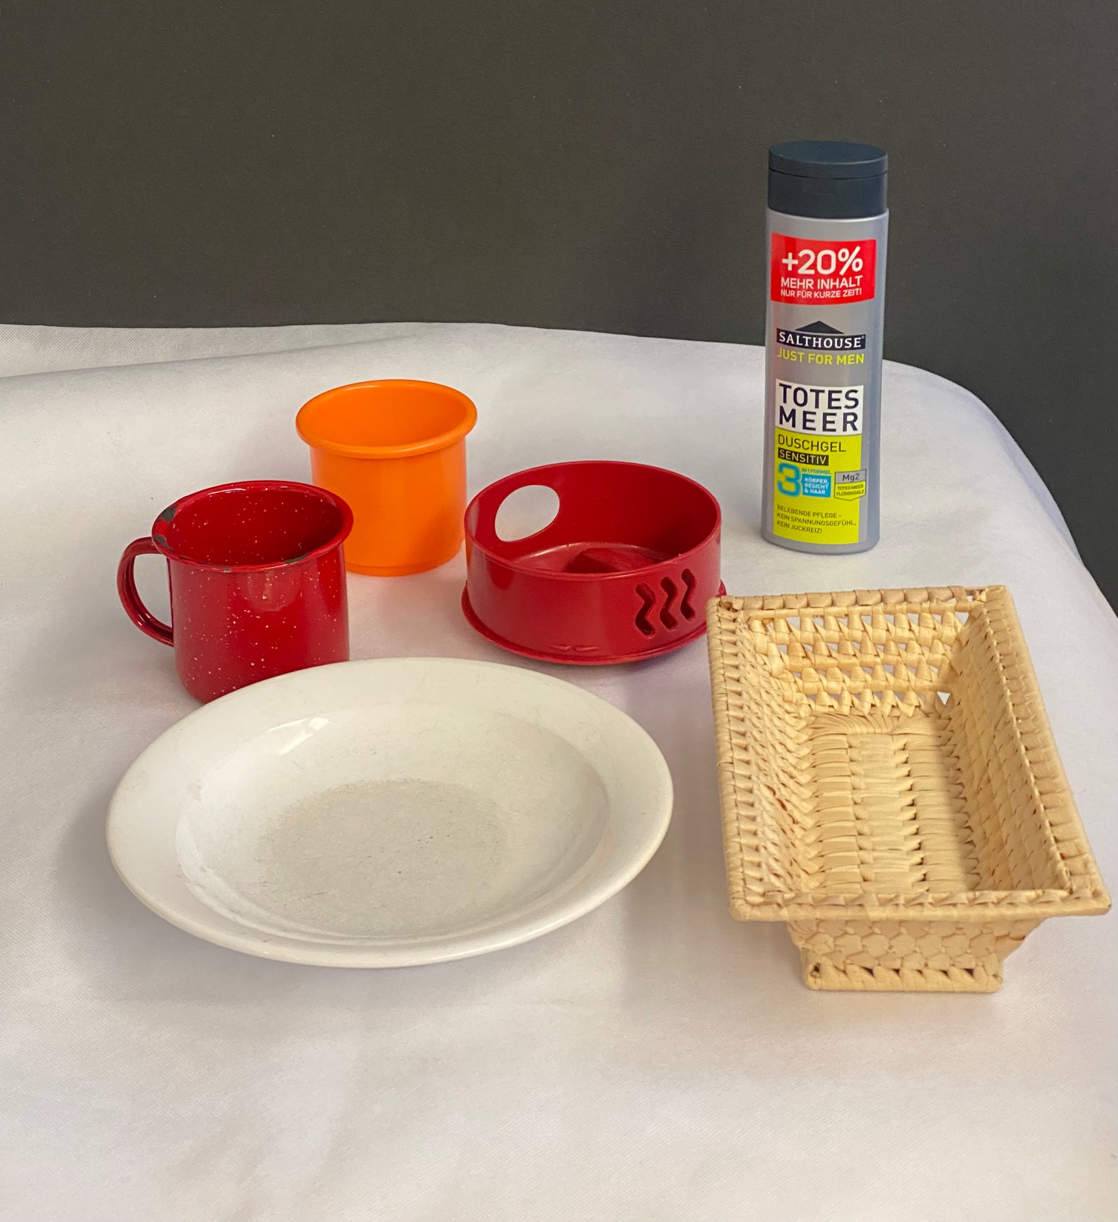
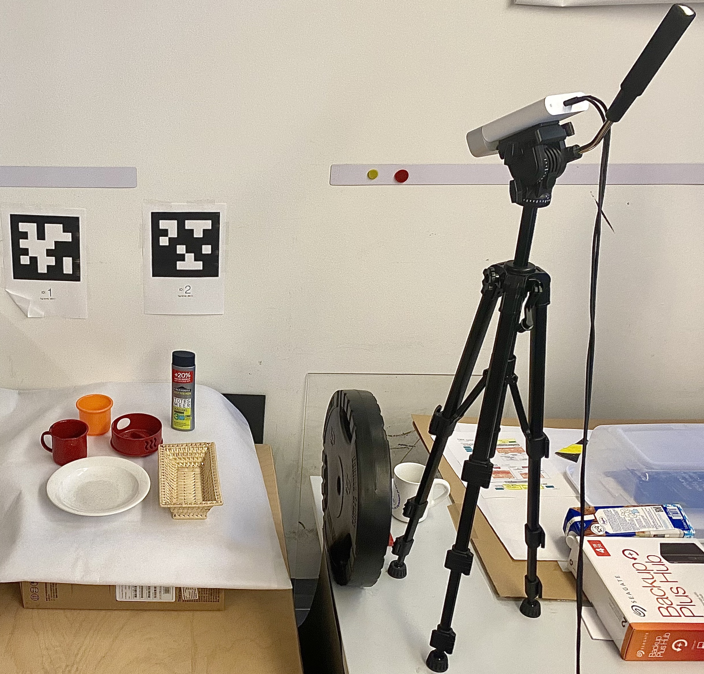
Experimental Setup
Introduction
Background and Motivation
Methodology
Results
Conclusion and Future work
Tested on 6 objects
Grasping individual objects using partial point clouds
Pose sampling on reconstructed point clouds
Abdullah Cem Özbay | Master’s Thesis | Final presentation, Munich, 13 June 2023
Notes:
We tested our method in two parts: First we tested highest grasp poses on 6 objects in real life.
These objects are : metal mug, plastic mug, a wicker basket, a plate, shampoo and a jug lid.
We individually placed the objects on the table and capture the point cloud of the objects,
then method found the highest-scoring grasp poses.
This high-scoring grasp poses are given to the robots motion planning and the robot tried to execute the grasp pose.
In the next part of the experiment, we sampled grasp poses on reconstructed point clouds.

Slide 29
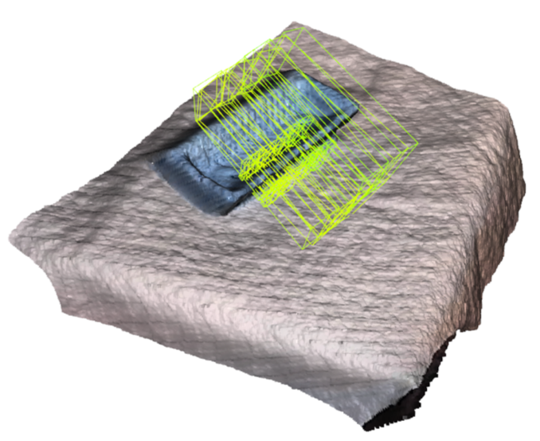
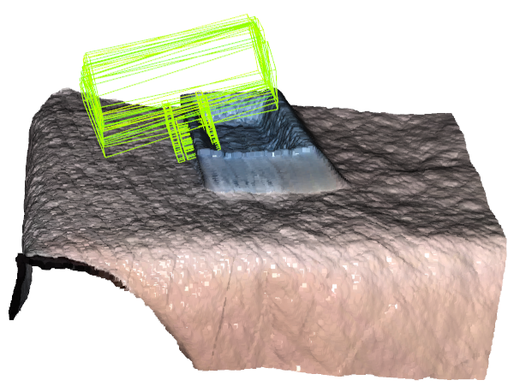
Grasping Individual Objects
Introduction
Background and Motivation
Methodology
Results
Conclusion and Future work
10/10 on wicker basket
Abdullah Cem Özbay | Master’s Thesis | Final presentation, Munich, 13 June 2023
Notes:
First test was on wicker basket. The point cloud of the basket was accurate; and Our algorithm found multiple high-scoring grasp poses on this accurate point cloud. Then we gave the 6 dimensional grasp configurations including the grasp width to robots motion planning.
All grasping attempts are executed by the robot,,,soo the test on wicker basket was very succesfull.
the method found feasible grasp poses and the robot was able to perform these poses on every trial.

Slide 30
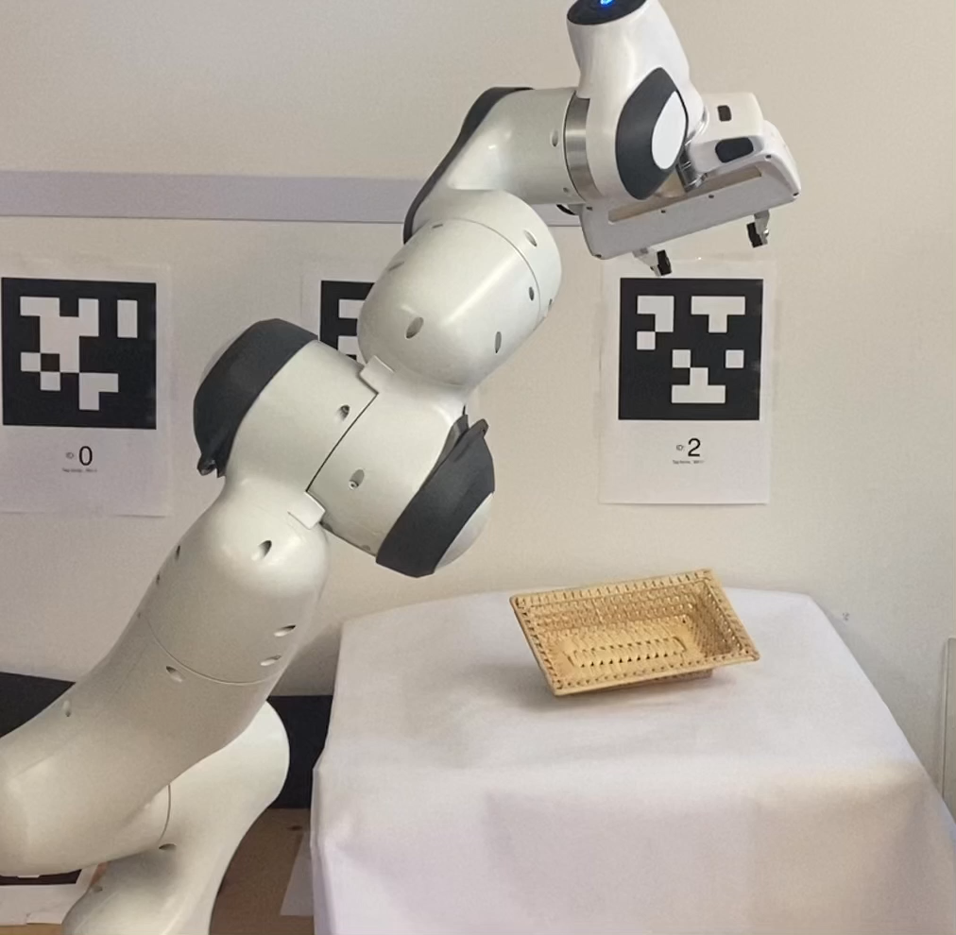
Grasping Individual Objects
Introduction
Background and Motivation
Methodology
Results
Conclusion and Future work
Abdullah Cem Özbay | Master’s Thesis | Final presentation, Munich, 13 June 2023
Notes:
Here we can see the video of the robot while executing the grasp pose found by our metod.
let us watch it quickly.

Slide 31
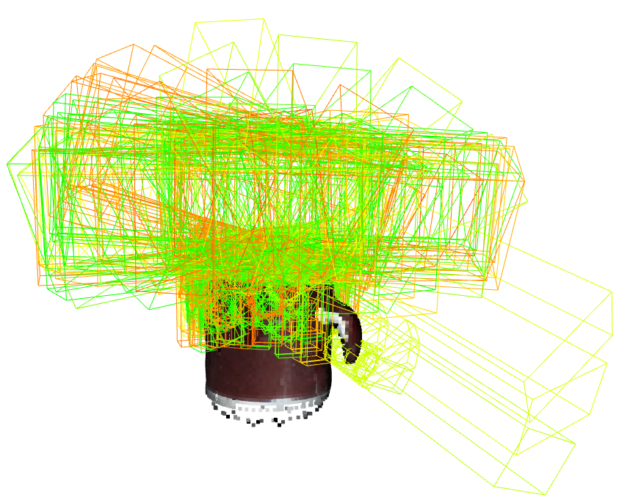
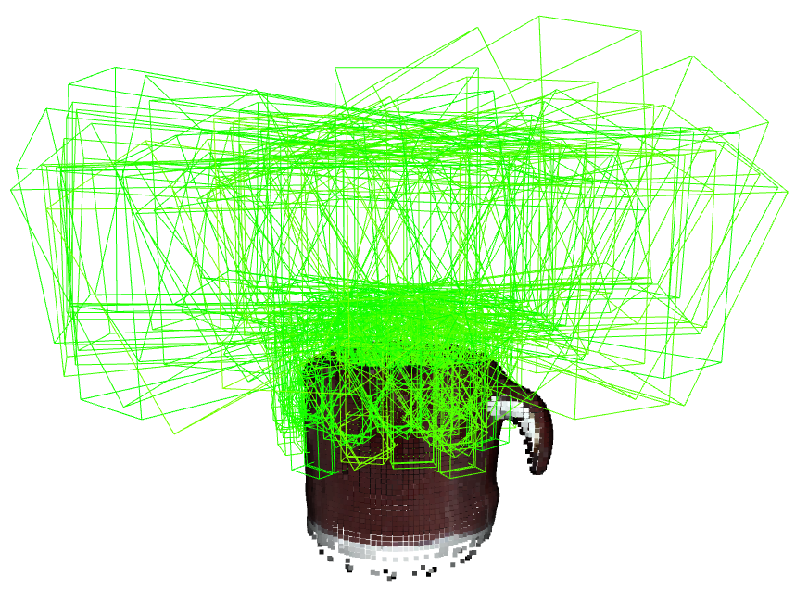
Introduction
Background and Motivation
Methodology
Results
Conclusion and Future work
Evaluation on Reconstructed Point Cloud
Reliable and efficient robotic grasping capabilities
Abdullah Cem Özbay | Master’s Thesis | Final presentation, Munich, 13 June 2023
Notes:
Here we have the reconstruced point cloud of a metal mug.
And it is obtained as a mesh from the YCB data set.
I used the meshlab tool to convert it into a point cloud.
SOO On this example, you can see when a point cloud is complete, our method finds too many realistic high-scoring grasp poses.

Slide 32
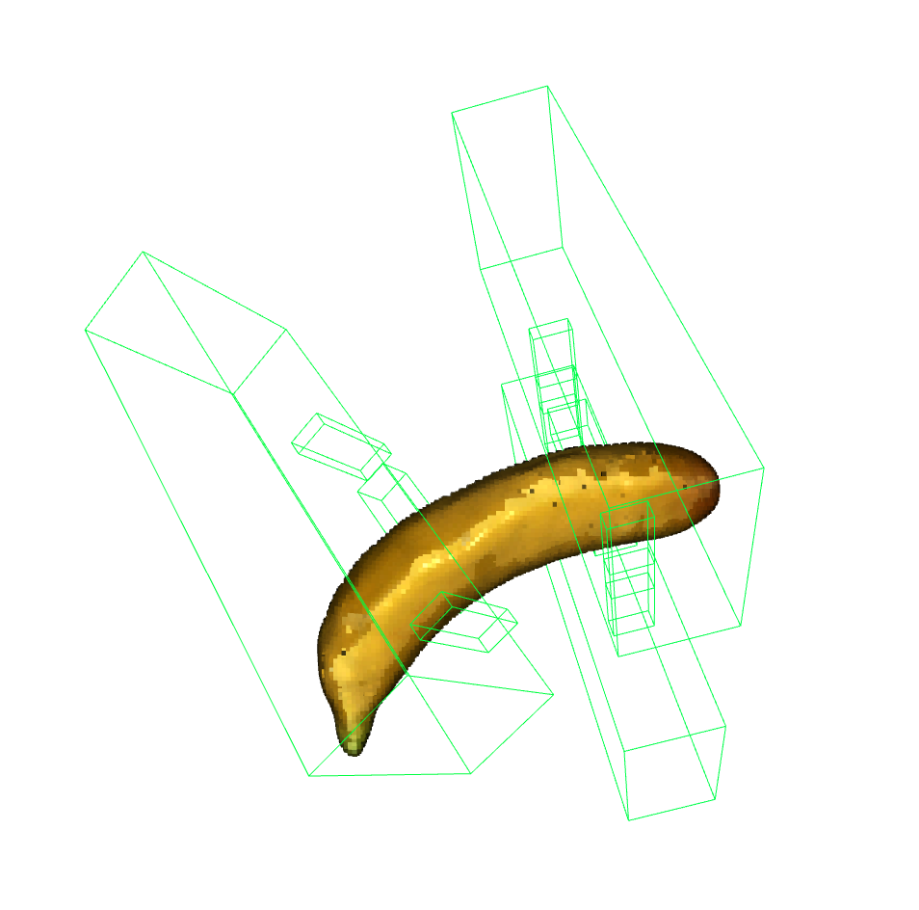
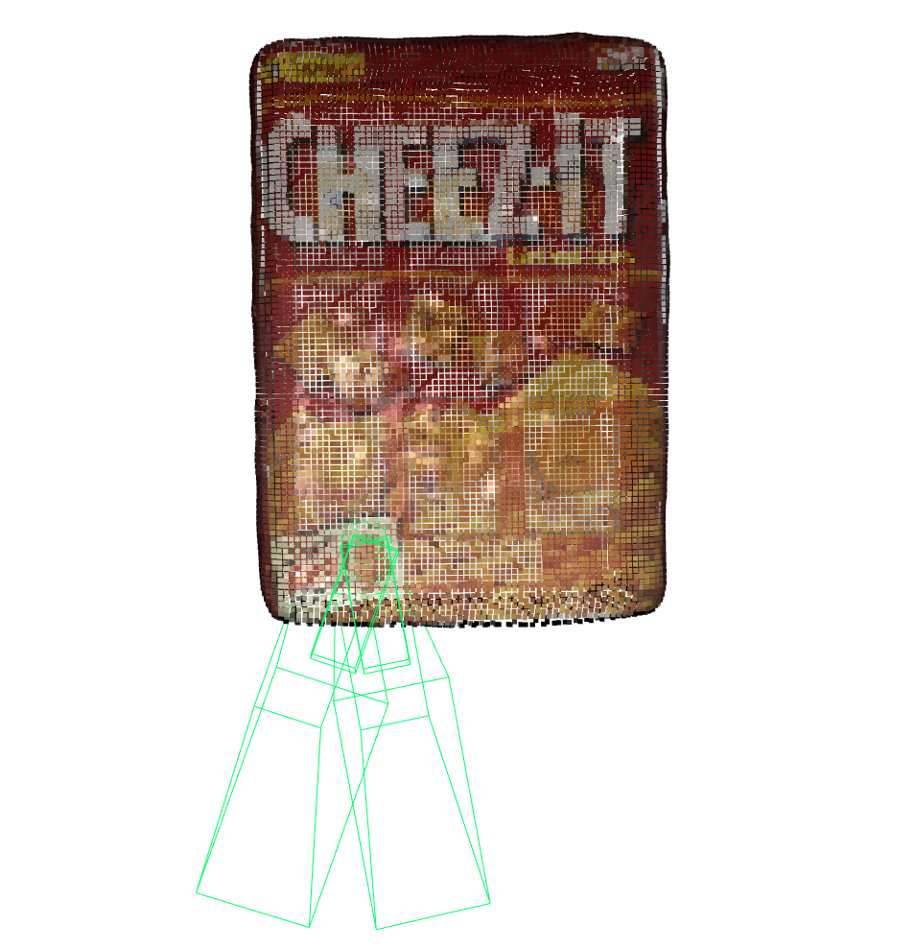
Introduction
Background and Motivation
Methodology
Results
Conclusion and Future work
Evaluation on Reconstructed Point Cloud
Performs well on complete point cloud
Abdullah Cem Özbay | Master’s Thesis | Final presentation, Munich, 13 June 2023
Notes:
Further on the experiments, we tested the the method on reconstructed point clouds of the banana and the cracker box.
Both have different shapes compared to the mug.
And the method finds again high-scoring realistic grasp poses as you can see from the figures.
this shows the versatility of the algorithm. It can detect feasible 6d grasp poses on arbitrarily shaped objects

Slide 33
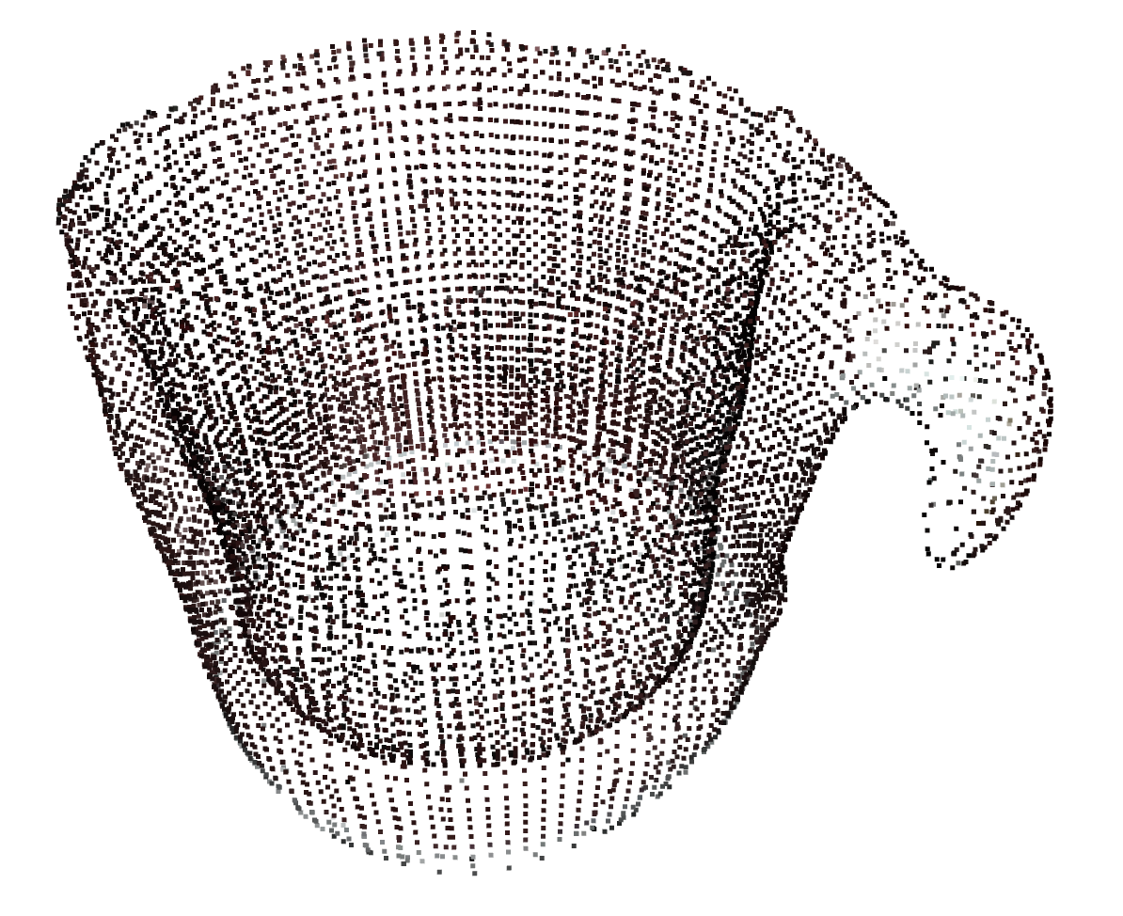
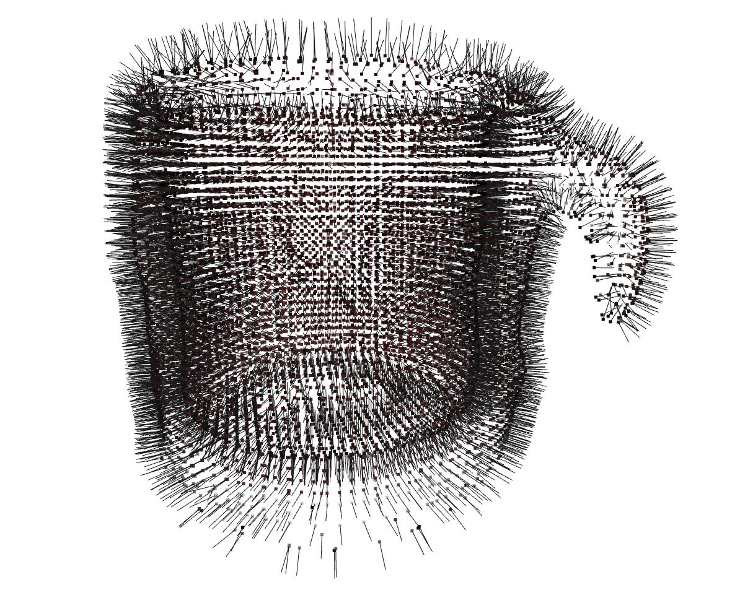
Evaluation on Reconstructed Point Cloud
Introduction
Background and Motivation
Methodology
Results
Conclusion and Future work
Complete representation of object’s geometry and surface
Robust surface normal estimation
Executable realistic grasp poses estimated
Abdullah Cem Özbay | Master’s Thesis | Final presentation, Munich, 13 June 2023
Notes:
In this second part of the experimental evaluation, we have worked on reconstructed point clouds. Reconstructed point clouds allows a complete representation of the object geometry and surface.
By that more robust surface normal estimation is obtained. You can see from the figure on the right side that surface normals represents the surface orientaion very well.
This is actually very important improvement since our approach is based purely on surface normals. With the use of reconsturced point clouds, we have seen that more realistic grasp poses are found.

Slide 34
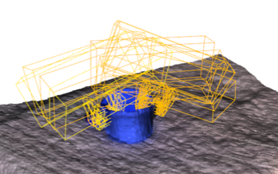
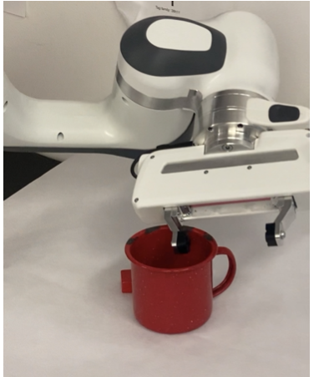
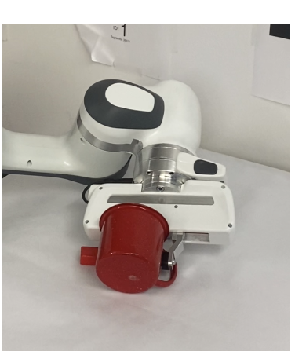
Grasping Individual Objects
Introduction
Background and Motivation
Methodology
Results
Conclusion and Future work
Low scoring grasp pose → Bad for robotic execution
Abdullah Cem Özbay | Master’s Thesis | Final presentation, Munich, 13 June 2023
Notes:
Here we have an example from the experimnent on metal mug. founded graso poses do not have high grasp scores. So executing this mediocre scoring grasp poses by robot was un succesfull.
You can see that the robot overturns the metal mug while grasping it.
This is actually the exact same mug with one we used at tests on reconstruced point clouds.
This example actualyy showes that our grasp quality metric represents the grasp quality very accurately. Execution of poses with low scores was failed.

Slide 35
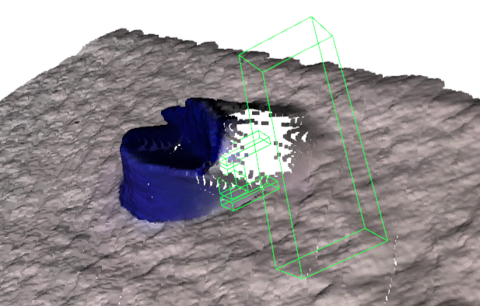
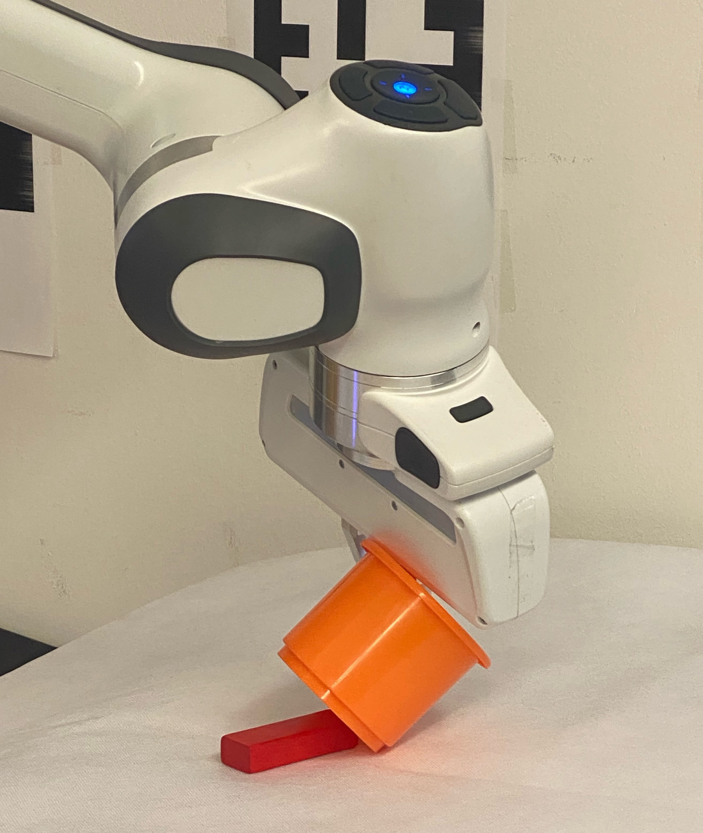
Grasping Individual Objects
Introduction
Background and Motivation
Methodology
Results
Conclusion and Future work
Bad execution caused by imperfections on partial point clouds
Abdullah Cem Özbay | Master’s Thesis | Final presentation, Munich, 13 June 2023
Notes:
However,our method could not perfom well on plastic mug. It is because of incompleteness of the partial point clloud. It can be seen from the figure left that the partial point cloud is not complete.
And the algorithm finds high scoring grasp poses behind the mug.
And as expected the robot couldn’t perfomed a succesful grasping. and collidide witjh object while executing the pose.

Slide 36
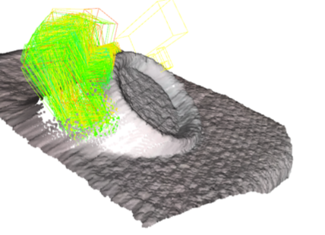
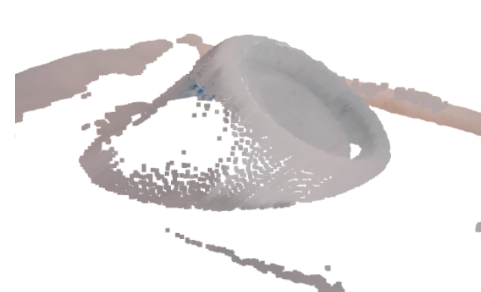
Grasping Individual Objects
Introduction
Background and Motivation
Methodology
Results
Conclusion and Future work
An incomplete partial point cloud can cause a collision
Abdullah Cem Özbay | Master’s Thesis | Final presentation, Munich, 13 June 2023
Notes:
In this example, we can see the method finds grasp pose at the back of the plate. However the grasp poses could not executed by the robot.
Because to perform the grasp, the robot needs to go under the plate, but this would cause the robot to collide with the table.
This collision couldn’t detected by our collision detection since the back of the plate was missing in partial point cloud.

Slide 37
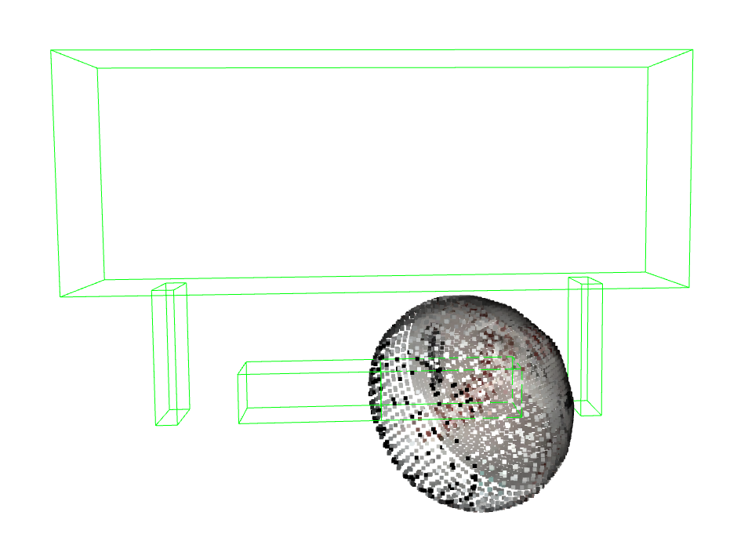
Introduction
Background and Motivation
Methodology
Results
Conclusion and Future work
Evaluation on Reconstructed Point Cloud
Wider grasp pose
Abdullah Cem Özbay | Master’s Thesis | Final presentation, Munich, 13 June 2023
Notes:
Next example is the baseball ball,
and as you can see, the center of the grasp pose is located in the middle left of the ball. you see it here with red dot.
this is because, we locate center point of the grasping area on points of the point cloud.
Therefore gripper must open its fingers wider to grasp large objects. As a result of it, by increasing the width of the grasp, the right side of the gripper covers the entire ball.
if this poses cause a problem in the future,
It can tried to define these points on the point cloud ,,
as the contact point of the finger instead of the grasping center.

Slide 38
Discussion
Introduction
Background and Motivation
Methodology
Results
Conclusion and Future work
The method is very promising in finding suitable 6-DOF grasp poses
The grasp score represents the grasp quality in terms of surface similarity
Colliding poses can be detected and eliminated
Complete and accurate point clouds → feasible high-scoring grasp poses
Generalized method
Abdullah Cem Özbay | Master’s Thesis | Final presentation, Munich, 13 June 2023
Notes:
Overall Results showed us that the develeped metbod is very promising for finding suitable 6d grasp poses.
The grasp score represents the grasp quality in terms of surface similarity between obj and gripper
And algorithm detects all the grasp poses that might collide with the enviorenmet and eliminates them
Besides, we obtained feasible high-scoring grasp poses on complete point clouds or on an accurate partial point clouds.
And the method is very versitale on grasping arbitarry shape objects. This shows the generalized method.

Slide 39
Discussion
Introduction
Background and Motivation
Methodology
Results
Conclusion and Future work
Incompleteness in the partial point clouds result in finding high-scoring grasping poses that are not feasible
Imperfections in the robot implementation, camera measurement variations, and environmental uncertainties → accumulated errors
Abdullah Cem Özbay | Master’s Thesis | Final presentation, Munich, 13 June 2023
Notes:
The observed downsides of the methods are as follows.
Incompleteness in the partial point clouds result in finding high-scoring grasping poses that are not feasible.
annd
We also seen that, Imperfections in the robot implementation, camera measurement variations, and environmental uncertainties cause accumulated errors for grasp estimation

Slide 40
Conclusion
Introduction
Background and Motivation
Methodology
Results
Conclusion and Future work
No training, no prior knowledge and the 3D model of objects is unknown
No computational, time and labor costs for dataset creation and training
Based only on surface normal and gripper finger shape
Accurately detects surface similarities between objects and the gripper finger
Perfoms well on accurate partial point clouds and reconstructed point clouds independent of the shape of the object
Abdullah Cem Özbay | Master’s Thesis | Final presentation, Munich, 13 June 2023
Notes:
As a conclusion, the method don’t need any training or any prior knowladge about the objects thus can perform well on unseen objects
Presented method eliminates the computational ,time and labor cost for data set creation adn training
Grasp quality metric is purely based on surface normals
its good at detecting suface similarities between the objects and grippers finger
and last, it. Finds feasible grasp poses on accurate partial point clouds and reconstructed point clouds, independent of the objects shape.

Slide 41
Future Work
Introduction
Background and Motivation
Methodology
Results
Conclusion and Future work
Work on reconstructed point clouds
Combine with object segmentation
Task-oriented grasping
Abdullah Cem Özbay | Master’s Thesis | Final presentation, Munich, 13 June 2023
Notes:
As a future work we suggest to work on reconstructed point clouds. Results clearly showed the advantage of working on reconstructed point clouds.
Also Our method can be combined with object segmentation
and the final improvement can be to add task-oriented grasp capability

Slide 42
Thank you for listening and I'll be glad to answer any questions you might have
Abdullah Cem Özbay | Master’s Thesis | Final presentation, Munich, 13 June 2023
Notes:
Thank you for listening and I'll be glad to answer any questions you might have

Slide 43
Bibliography
[1] Anthony Simeonov, Yilun Du, Andrea Tagliasacchi, Joshua B Tenenbaum, Alberto Rodriguez, Pulkit Agrawal, and Vincent Sitzmann. Neural descrip- tor fields: Se (3)-equivariant object representations for manipulation. In 2022 International Conference on Robotics and Automation (ICRA), pages 6394–6400. IEEE, 2022.
[2] Charles R Qi, Hao Su, Kaichun Mo, and Leonidas J Guibas. Pointnet: Deep learning on point sets for 3d classification and segmentation. In Proceedings of the IEEE conference on computer vision and pattern recognition, pages 652–660, 2017.
[3] Sulabh Kumra and Christopher Kanan. Robotic grasp detection using deep convolutional neural networks. In 2017 IEEE/RSJ International Conference on Intelligent Robots and Systems (IROS), pages 769–776. IEEE, 2017.
[4] Fang, Hao-Shu, et al. "Graspnet-1billion: A large-scale benchmark for general object grasping." Proceedings of the IEEE/CVF conference on computer vision and pattern recognition. 2020.
[5] Jeffrey Mahler, Jacky Liang, Sherdil Niyaz, Michael Laskey, Richard Doan, Xinyu Liu, Juan Aparicio Ojea, and Ken Goldberg. Dex-net 2.0: Deep learning to plan robust grasps with synthetic point clouds and analytic grasp metrics. 2017.
[6] Deng, Jia, et al. "Imagenet: A large-scale hierarchical image database." 2009 IEEE conference on computer vision and pattern recognition. Ieee, 2009.
[7] Yun Jiang, Stephen Moseson, and Ashutosh Saxena. Efficient grasping from rgbd images: Learning using a new rectangle representation. In 2011 IEEE International conference on robotics and automation, pages 3304–3311. IEEE, 2011.
[8] A.T. Miller and P.K. Allen. Graspit! a versatile simulator for robotic grasp- ing. volume 11, pages 110–122, 2004.
[9] Maxime Adjigble, Naresh Marturi, Valerio Ortenzi, Vijaykumar Rajasekaran, Peter Corke, and Rustam Stolkin. Model-free and learning-free grasping by local contact moment matching. In 2018 IEEE/RSJ Interna- tional Conference on Intelligent Robots and Systems (IROS), pages 2933– 2940. IEEE, 2018.

